Slide 1
IV Pump Integration with Epic
Overview for HMW
Sept. 19, 2022
Updated Sept. 19, 2022

Slide 2
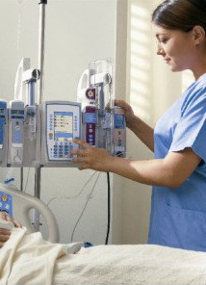
Overview
IV Pump Integration
IV Pump Integration seamlessly integrates
with Epic for improved patient safety
and more efficient documentation.
IV Pump Integration begins at HMW on
Monday, Oct. 31 and will complete the
systemwide launch throughout 2022.
Classroom-based training starts Monday, Oct. 3
in the Maple Computer Room at HMW. Courses are
interactive, hands-on and last approx. two hours.
Appropriate courses have been assigned in
LMS for impacted staff, who must register
for a specific session in LMS.

Slide 3
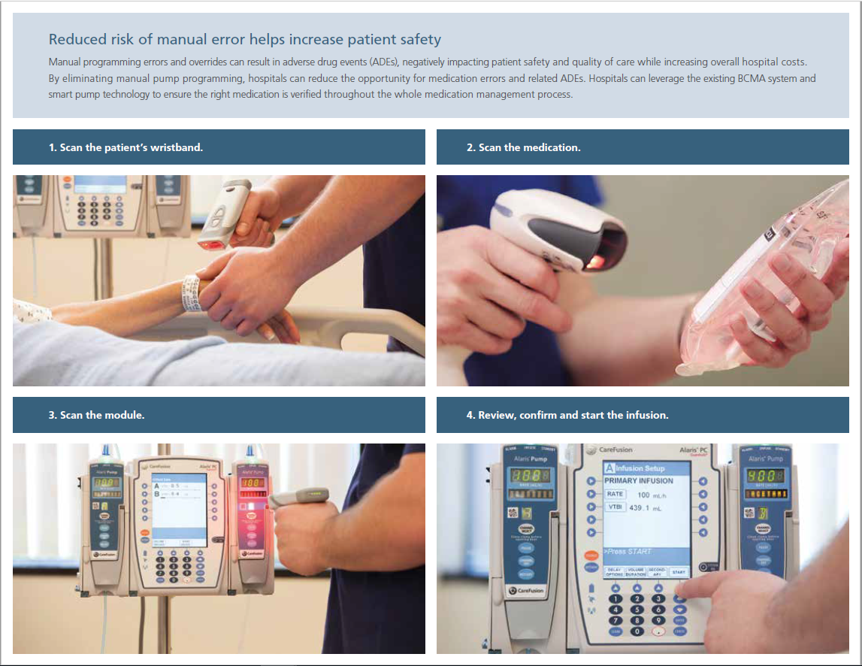
Basic How-To
IV Pump Integration

Slide 4
Impacted Units
IV Pump Integration
HMW areas in scope include:
Med/Surg (5 East, 5 Northwest, 5 Southwest, 6 East, 6 Northwest, 6 Southwest)
ED and Cinco Ranch ECC
ICU
Infusion
PACU
Women’s Services (L&D, Mother/Baby, NICU, OB ED)

Slide 5
Why Are We Doing It?
IV Pump Integration
IV Pump Integration is easy to use, with fewer buttons
to click and automated documentation
of infusion start/stop times.
Allows you to spend less time documenting and more
time caring for patients when administering IV infusions.
Reduces the need to manually search for, enter
and document IV med details.
Documentation will be more detailed and precise,
enabling better patient outcomes.
Decreases errors when managing
complex IV infusions and improves patient safety.

Slide 6
Training
IV Pump Integration
Classroom-based training is assigned in LMS.
Impacted nurses need to register in LMS for the applicable Epic IV Pump Integration Training session for their role.
Critical Care/ICU Departments – Course ID 1594004
Classes are in the Maple Computer Room at HMW.
Each course is approx. two hours long.
Deadline for training completion is Friday, Oct. 28.
Infusion Therapy – Course ID 1589057
OB Departments – Course ID 1594003
All Other Depts – Course ID 1589055
Emergency Department – Course ID 1589056
Super User – Course ID 1589062

