Slide 1
IV Pump Integration – HMCCH
Meeting in a Box
September 19, 2022

Slide 2
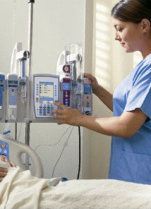
IV Pump Integration – An Overview
IV Pump Integration – HMCCH
IV Pump Integration seamlessly integrates with Epic for
improved patient safety and more efficient documentation.
IV Pump Integration begins at HMCCH on Nov. 14, 2022,
marking the conclusion of systemwide implementation.
Classroom-based training will be held Oct. 3 to Oct. 28 in the
Maple Computer Room at HMW. Courses are interactive,
hands-on and last approx. two hours.
Appropriate courses have been recommended in LMS for impacted staff,
who must register for a specific session in LMS.

Slide 3
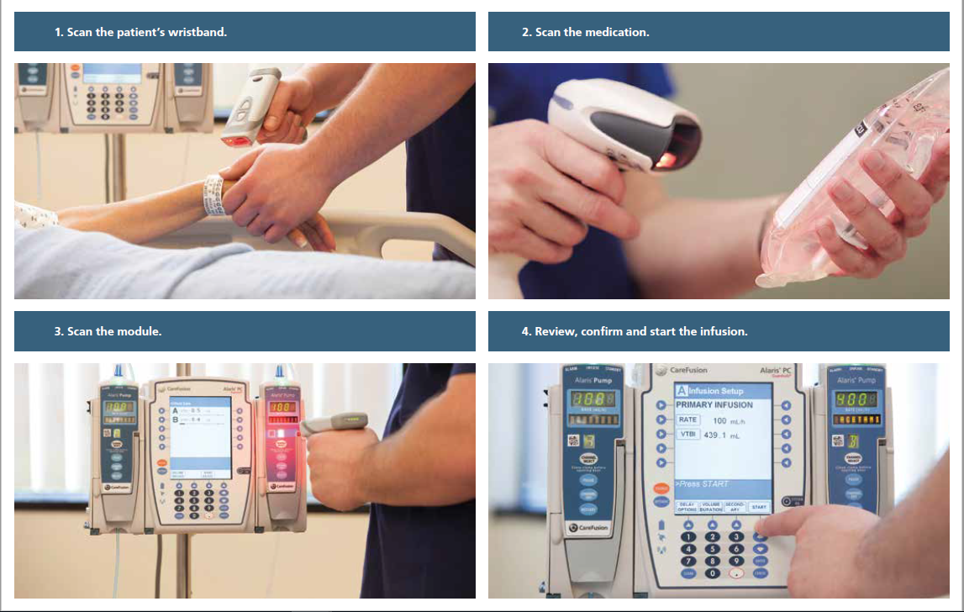
Project Overview
IV Pump Integration – HMW/HMCCH
Reduced risk of manual error helps increase patient safety.
Manual programming errors can result in adverse drug events (ADEs), negatively impacting patient safety and quality, while increasing overall hospital costs.
Eliminating manual pump programming can reduce the opportunity for medication errors and related ADEs.
Leveraging our existing BCMA system and smart pump technology ensures the right medication is verified throughout the whole medication management process.

Slide 4

Impacted Units
IV Pump Integration – HMCCH
HMCCH Units In-Scope
Med/Surg (2 East, 2 South)
ICU (2 West)
HMH Jones LTACH

Slide 5
Training
IV Pump Integration – HMCCH
Classroom-based training is assigned in LMS.
Impacted nurses need to register in LMS for the applicable Epic IV Pump Integration Training session for their role.
Critical Care/ICU Departments – Course ID 1594004
Classes are in the Maple Computer Room at HMW.
Each course is approx. two hours long.
Deadline for training completion is Friday, October 28.
All Other Depts – Course ID 1589055
Super User – Course ID 1589062

Slide 6
Why Are Integrating IV Pumps?
IV Pump Integration - HMCCH
IV Pump Integration is easy to use, with fewer buttons to click
and automated documentation of infusion start/stop times.
Allows you to spend less time documenting and more
time caring for patients when administering IV infusions.
Reduces the need to manually search for, enter
and document IV med details.
Documentation will be more detailed and precise,
enabling better patient outcomes.
Decreases errors when managing
complex IV infusions and improves patient safety.

