Slide 1
Aug. 14 Epic Update
Research
Meeting in a Box
Updated: July 25, 2022

Slide 2
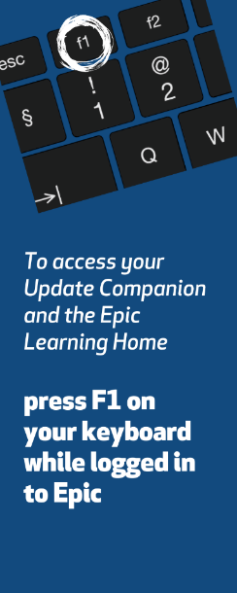
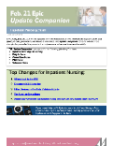
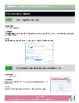
Next Epic Update
Sunday, August 14
Prepare for the next Epic Update
on Sunday, August 14
Understand the top changes for your role or department.
Review your Update Companion:
  Press F1 while in Epic to get to the Learning Home
  Read eNewsletters
  it.houstonmethodist.org/epicupdate/
Practice using Guided Activities in the Epic Playground.
1
2
3

Slide 3
Aug. 14 Epic Update
Highlights of Upcoming Changes for Everyone
High-Level Overview
In Basket redesigned with new features to help organize work, review messages and care for patients.
New Registration Navigators with improved workflows and enhanced functionality.
New BookIT scheduling tool.
Improvements to Secure Chat
Set availability status to Do Not Disturb or Offline when you aren’t available.
  Do Not Disturb – receive push notifications for high-priority messages.
  Offline – no one can send you messages.
Quickly attach a patient chart to a conversation.
Similar patient names are bolded and italicized.

Slide 4

Aug. 14 Epic Update
Epic Downtime and Limited Functionality Period
Planned Epic Downtime
Sunday, Aug. 14 from 2 to 3:30 a.m.
Some Epic Functionality Unavailable
5 a.m. Wednesday, Aug. 10 to 3:30 a.m. Sunday, Aug. 14
During the downtime, access the Epic Read-Only icon on your workstation desktop.
  Data in Epic Read-Only is current
  until the downtime begins.
  You can’t document or enter orders in Epic Read-Only.
For details on what to do before, during and after the downtime, including special instructions for lab, radiology, cardiology and medical devices, visit it.houstonmethodist.org/downtime.
Some Epic functions will be unavailable, and no changes or enhancements will be made.
You’ll still be able to work in Epic as usual, but you won't be able to do the following:
  Apply filters in Chart Review.
  Create, edit and share NoteWriter macros, SmartPhrases and SmartLinks.
  Create and edit In Basket QuickActions.

Slide 5

Top Changes for Research
August 14 Epic Update
The Top Changes for
Research Coordinators:
Capture Status Effective Dates for Research Study Enrollments
See Study Charges That Might Have Been Routed Incorrectly
New Research Icon Has an Edge
Click here for the
Research Coordinators
Update Companion
Must be connected to the HM Network

