Slide 1
Houston Methodist
Training November 2021
Notes:
RECORD
Welcome to Calendar Lead Training-Intro Lisa Garcia (Applications Analyst-Demo & David-IT Training-Scope & Next Steps)
Attendance-Requested 1 Calendar Lead and a back-up for each service area (others are welcome in these sessions but we will focus on the Calendars Leads duties.
Calendar Lead maintain the coverage calendar for their service area (SharePoint now)
The project team has created calendars for each service area as a start for your work
In this hour we will review the scope, milestones and your next steps then Lisa will do a demonstration using one of your calendars
Please put your questions in the Chat and if we have time we will cover them at the end of the session, if we run out of time we will answer in the Chat after this session
We have scheduled another class like this on Thursday, 11/18 from 11 am to Noon and a Help session on Friday, 11/19 from 9 to 10 am to answer your questions. You should have received an invite.
We will schedule additional Help sessions as needed.

Slide 2
Agenda
Scope & Project Milestones
System Access
Org Structure
Data Management
    Contact Information
    On-call Response
On-call schedules
      Functional overview
      Calendar Access
Member Portal
Next Steps
Notes:
This is our agenda for the first part of the hour after which Lisa will Demonstrate your duties as a Calendar Lead using one of your calendars.

Slide 3
Scope and Project Milestones
Scope
Schedules to be completed
Go-Live
Centralizing on-call schedules into Everbridge. No longer using SharePoint.
11/22
12/7
Everbridge will be used for all major incidents and pageable events going forward.
The whole group will be paged if schedules are not built.
Notes:
As of 12/7/2021 we will use Everbridge for IT Alerting for all major incidents & pageable events.
Everbridge rather the IT Service Desk will alert for these events
We will discontinue using SharePoint for these alerts as of Monday, 12/7/2021
Calendar Leads will review & revise their Calendars by Friday, 11/22/2021
If calendars are not revised the whole team will be paged as of Monday,12/7/2021

Slide 4

System Access
Single Sign-On is configured so username and password is not needed.
Manager Portal:
https://manager.everbridge.net/saml/login/ManagerPortalITAMethodist
For calendar leads responsible for managing the on-call schedules.
For Everbridge system administrators to manage the platform configurations.
AD Group: APL_Everbridge_Mgr_Portal
Member Portal:
https://member.everbridge.net/index/453003085613180
For on-call analyst to manage availability
To view published calendars
AD Group: None; all the company can access
Notes:
Manager Portal is where you review and revise the on-call calendar(s) for your service area
Calendar Leads: If you have not done so, after this class, please make sure you have access.
If you do not have access, email Lisa Garcia.
Manager Portal is where IT team members can view published calendars, manage availability and designate replacements. Accessible by all HM Employees after 12/7/2021

Slide 5
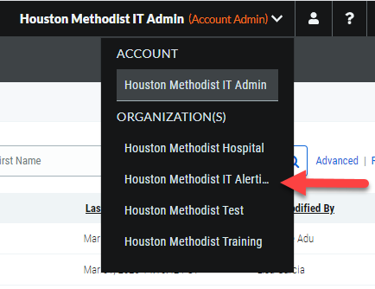
Org Structure
Name ORG: Houston Methodist IT Alerting
Email-ID: IT Alerting
Caller-ID: 832-667-5609
Depending on access you may also have access to Houston Methodist Test
Notes:
You will have access to Houston Methodist IT Alerting and you may have access to Houston Methodist Test.
When you get an alert, the email will say IT Alerting and will shows 832-667-5609 on caller ID. Those on your calendars should add this to contacts.

Slide 6
Data Management

Slide 7
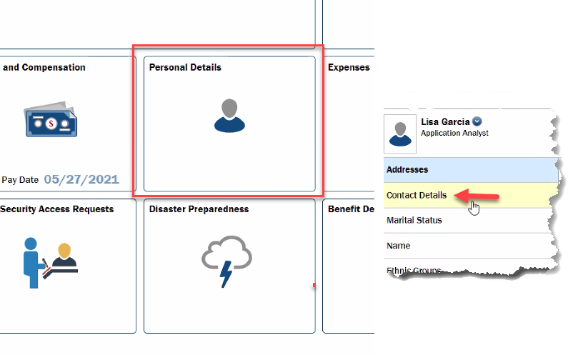
Data Management
As the Calendar Lead you are responsible for group membership within Everbridge and adding members to the on-call calendars.
Everbridge will contact the on-call analyst using information on the contact profile.
Notifications are configured for Business Cell SMS and Mobile, so it is important the contact information is up-to-date.
Contact information for the on-call analyst is maintained in MARS.
Daily SFTP file will populate Everbridge with MARS contact details Monday – Friday at 6:00AM (CST) Deletes will occur Mondays at 8:00AM (CST)
Notes:
As the Calendar Lead you are responsible for group membership within Everbridge and adding members to the on-call calendars as you have new members.
Everbridge will contact the on-call analyst using information on the contact profile generated from MARS-Personal Details.
Notifications are configured for text and phone, so it is important the contact information is up-to-date.
Contact information for those on-call is maintained in MARS.
Contact data is updated in Everbridge from MARS contact details Monday – Friday at 6:00AM Deletes will occur Mondays at 8:00AM

Slide 8
On-Call Analyst
The on-call analyst may receive an alert from Everbridge via SMS or a call to the designated phone number for Emergency/High pageable events.
This is for response time not resolution time.
The on-call analyst must choose to accept or escalate.
  Phone (voice) is 1 or 2
  Text is Yes / No
The agent will be paged on SMS first with a 3-minute pause before a phone call with a 5-minute delay before attempting again. The system will attempt 3 times.
The system is set to escalate to backup within 15-minutes
Calendars are set to escalate within 20-minutes of no response to the next layer.
  Note if the agent selects the decline option, 2, or No, then the escalation will happen at that moment (before the set escalation times).
  Management escalation is configured on the calendar and should be 20 minutes as standard.
Notes:
Your team members may receive an alert from Everbridge via text or a call to the designated phone number for major incidents & pageable events.
This is for response time not resolution time.
The on-call team member must choose to accept or escalate.
Phone (voice) is 1 or 2
Text is Yes / No
The team member will be paged first by text with a 3-minute pause before a phone call then a 5-minute delay before attempting again. The system will attempt 3 times.
Calendars are set to escalate within 20-minutes of no response to the next layer.
Note if the agent selects the decline option, 2, or No, then the escalation will happen at that moment (before the set escalation times).
Management escalation is configured on the calendar and should be 20 minutes as standard.

Slide 9
On-Call Schedules
Overview
Notes:
As Calendar Lead, you are responsible to the On-Call Schedules for your team.

Slide 10
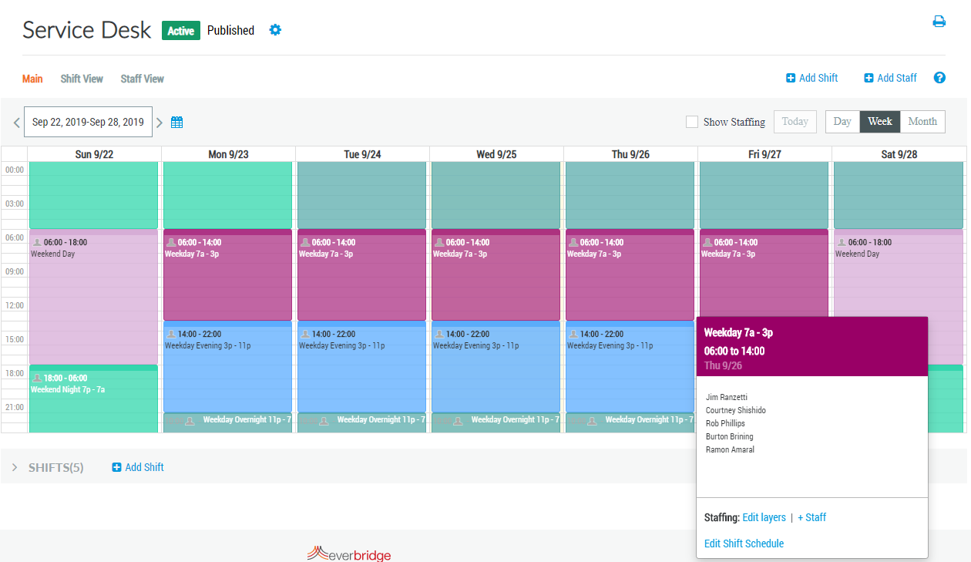
Calendar Overview
Create an unlimited number of calendars
Create daily, weekly or monthly shifts
Manage calendars in multiple views
Publish calendars across teams
Define shift with staffing layers to match coverage times
Assign staff to shifts for specific days, a range of dates or a regular recurring schedule
Use staffing layers to create rotation within a shift and define escalation levels
Manage staff availability and temporary replacements (self-service enabled)
Audit calendar changes to ensure teams are managing calendars appropriately
Notes:
Lisa will be demonstrating all of this so we will go through it rather quickly.
You may create an unlimited number of calendars as you do now in SharePoint
Create daily, weekly or monthly shifts
Publish and unpublish calendars across teams
Define shift with staffing layers to match coverage times
Assign staff to shifts for specific days, a range of dates or a regular recurring schedule
Use staffing layers to create rotation within a shift and define escalation levels
Manage staff availability, temporary replacements and holiday coverage (Member Portal for self-service)
Audit calendar changes to ensure teams are managing calendars appropriately

Slide 11
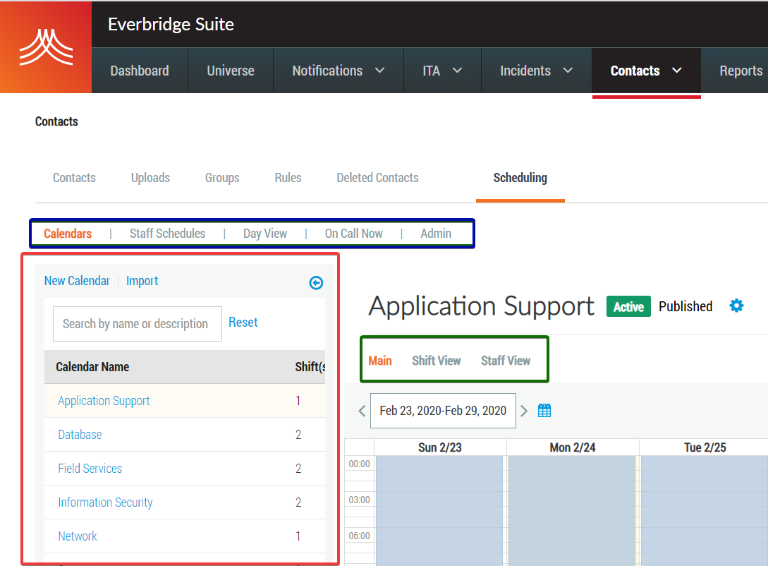
Calendars Management
Contacts>Scheduling
View your on-call calendars using the navigation tree in the left-hand side of the page.
Search for specific calendars by name or description using the search box
Review individual Staff Schedules or get a Day View of every on-call calendar on one page
Access the list of contacts listed as On Call Now and quickly see who is on call for which calendar
Audit calendar, shift and staffing changes using the Admin tools
Within each calendar, access a Shift View and Staff View to get better insight to your staffing
Notes:
View your on-call calendars.
Search for specific calendars by name or description using the search box.
Use On Call Now to quickly see who is on call for which calendar.
Within each calendar, access a Shift View and Staff View to get better insight to your staffing

Slide 12
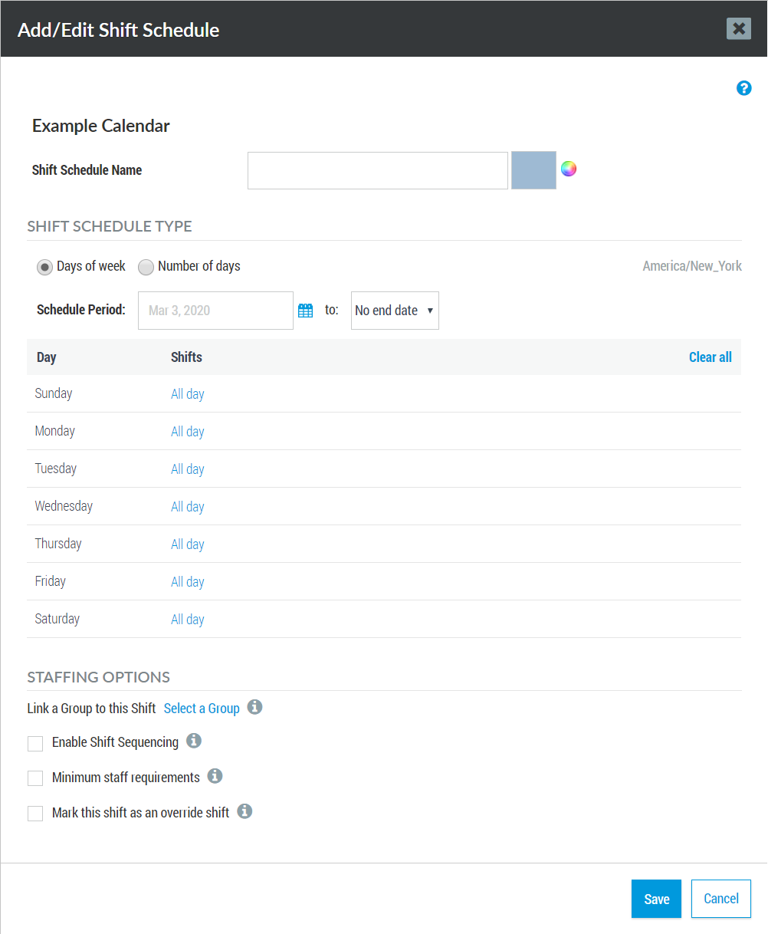
Shifts
Contacts>Scheduling>Calendar>Add Shift
Set a Shift Schedule Name that is descriptive of the calendar (e.g., 24x7 or Business Hours) – if creating multiple shifts, use a different color for each one.
Customize the shift timing to create different types of shifts (by default ‘All day’ means 12am to 12am).
Link a Group to this Shift – This requires the group to exist first.
If using Everbridge for automatic escalation, Enable Shift Sequencing to escalate through staffing layers until someone acknowledges.
Notes:
Lisa will demonstrate each of these steps:
Set a Shift Schedule Name that is descriptive of the calendar (e.g., 24x7 or Business Hours)
Customize the Shift Timing to create different types of shifts (by default ‘All day’ means 12am to 12am). You’ll want to change this.
Link a Group to this Shift – This requires the group to exist first.
Enable Shift Sequencing to escalate through staffing layers until someone acknowledges.

Slide 13
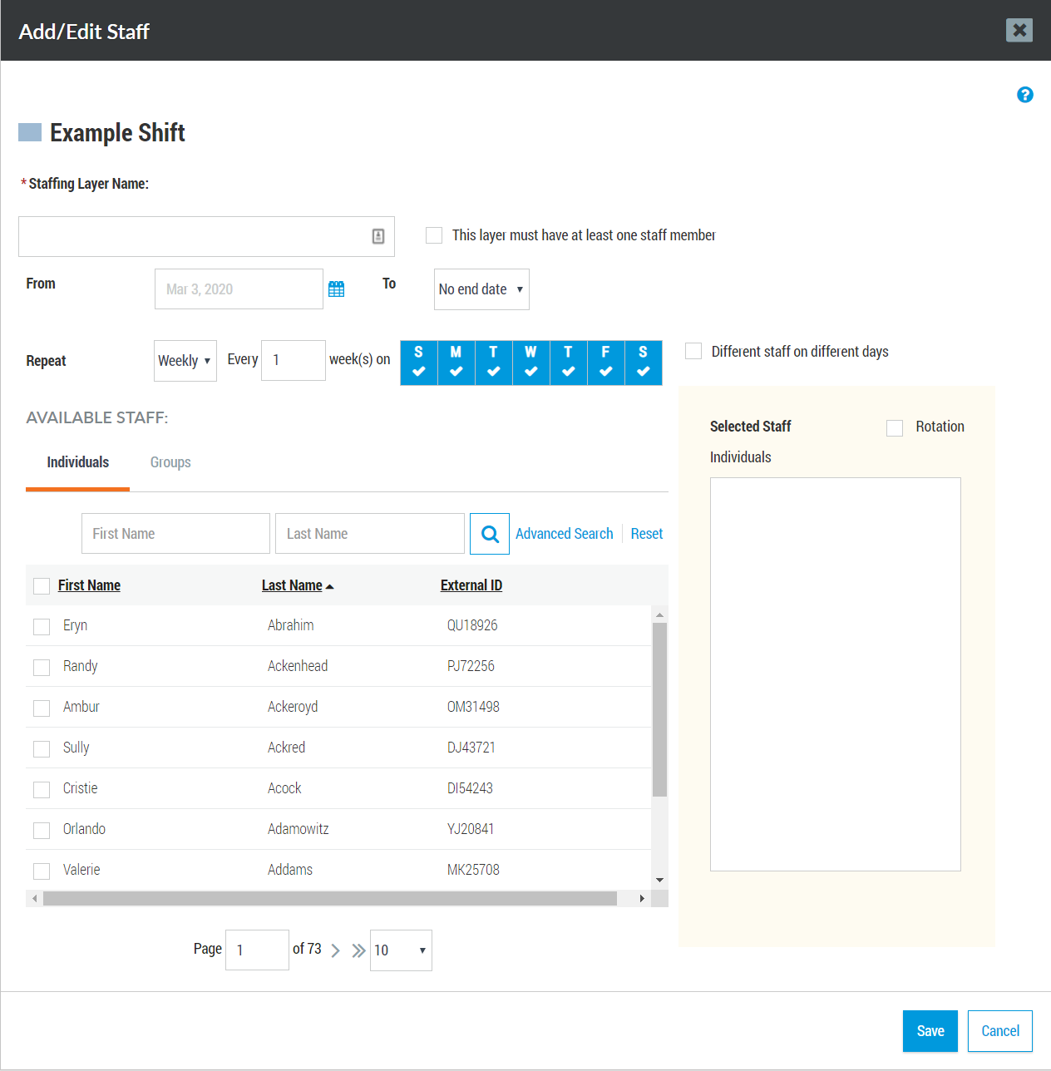
Staffing Layers
Contacts>Scheduling>Calendar>Shift>Add Staff
Choose a Staffing Layer Name that is descriptive of the people who will staff it (e.g., Primary, Secondary, Manager)
Ensure that This layer must have at least one member is checked so that no layer is inadvertently left unstaffed
Optionally, you can choose to staff different people on different days using the Different Staff on Different days checkbox
Add either Individuals or Groups to your Staffing Layer
Configure a Rotation to cycle through your available staff and swap to a fresh person on daily, weekly, or monthly cadence.
*Note: If you don’t see the individuals to select, they may not be in the group you have access to. Reach out to your Everbridge system administrator to confirm group membership and access.
Notes:
Choose a Staffing Layer Name that is descriptive of the people who will staff it (e.g., Primary, Secondary, Manager)
Ensure that This layer must have at least one member is checked so that no layer is inadvertently left unstaffed
Add either Individuals or Groups to your Staffing Layer
Configure a Rotation to cycle through your available staff and swap to a fresh person on a daily, weekly, or monthly basis.
*Note: If you don’t see the individuals to select, they may not be in the group you have access to. Reach out to Lisa Garcia to confirm group membership and access.

Slide 14
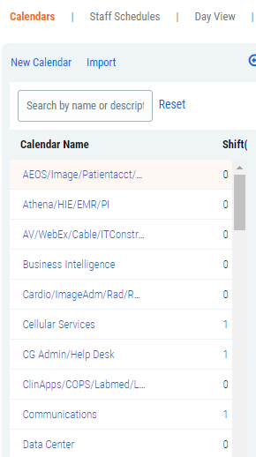
Calendar Access
Contacts>Scheduling
Access is granted by Group Manager role named Calendar Leads. Anyone in the Group Manager role can see and edit all calendars.
Your Everbridge system administrator will grant you access to this role directly in Everbridge.
Notes:
Your role in Everbridge is Calendar Lead
Contact Lisa Garcia if you do not have that role.

Slide 15
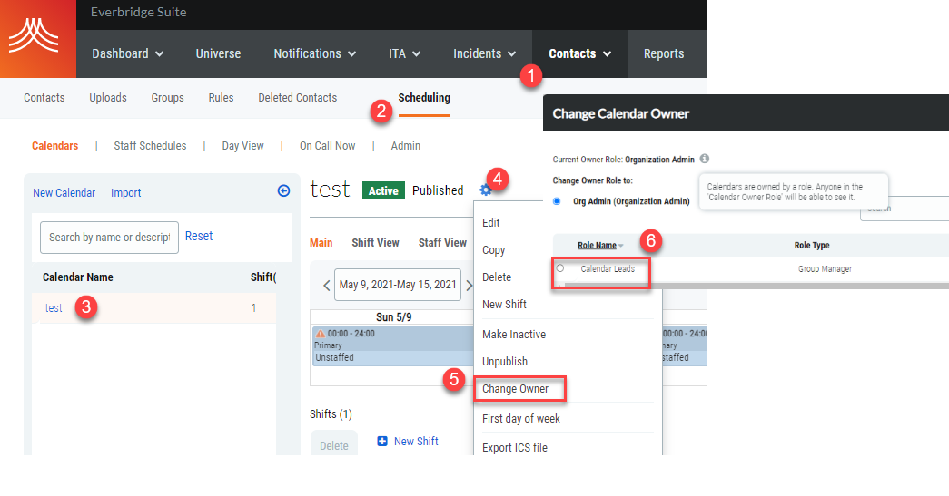
Calendar Owner
Contacts>Scheduling
Since access is granted by Group Manager role of “Calendar Leads”, the calendar ownership must be updated.
*Note: If the calendar does not appear in the left navigation window, contact your Everbridge system administrator. They may need to update the calendar owner to “Calendar Leads.”
Notes:
Note: If the calendar does not appear in the left navigation window, contact Lisa Garcia. She may need to update the calendar owner to “Calendar Leads.”

Slide 16
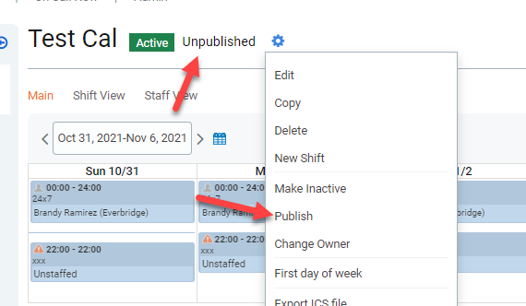
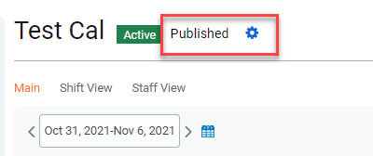
Calendar Published
Using the same gear icon to update the calendar owner – there is an option to Publish the calendar.
Publishing a calendar makes it
Available for view on the Member Portal
Allows the self-service for “unavailability”
You can have an “active” calendar and not “published”
Notes:
Whether you publish your calendars or not is your decision,
Publishing a calendar makes it available for viewing on the Member Portal
Allows self-service for “unavailability”, etc.
Calendars must be Active for Everbridge to page your team. If inactive, everyone in your group will be paged.

Slide 17
Member Portal
Notes:
Lisa will demonstrate the Member Portal
We will have brief demonstrations of Member Portal for everyone in IT the Week of 11/29

Slide 18
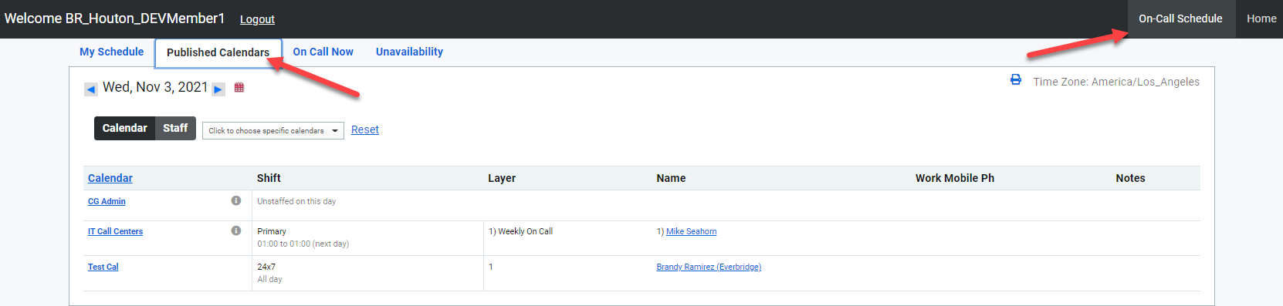
Member Portal – Published Calendar
From the Member Portal select > On-Call Schedule > Published Calendars
You can have an “active” calendar and not “published”

Slide 19
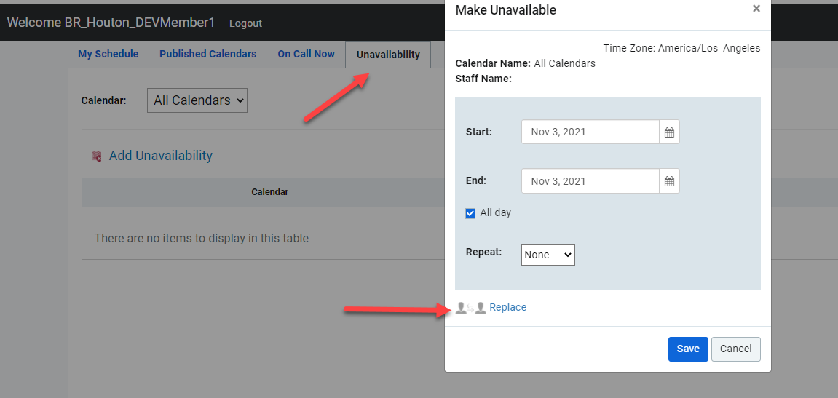
Member Portal – Unavailability
From the Member Portal select > On-Call Schedule > Unavailability
The on-call analyst can add a replacement

Slide 20
Next Steps

Slide 21
Calendar Lead – Next Steps
As the calendar lead, you are responsible for the on-call schedule ensuring it is staffed and active.
Ensure you have access to scheduling ASAP. Reach out to Lisa C Garcia if you do not have access.
Build your schedules by 11/22
  Staff your support group (add/remove contacts)
  Ensure your calendar is ACTIVE
  Ensure your calendar is PUBLISHED if desired
  Link your group and calendar
Project team will audit the status in preparation for go-live (12/7)
Tip sheets are available for reference
Notes:
As the calendar lead, you are responsible for the on-call schedule ensuring it is staffed and active
Ensure you have access to the Manager Portal. Reach out to Lisa C Garcia if you do not have access.
Build your schedules by 11/22
Staff your support group (add/remove contacts)
Ensure your calendar is ACTIVE
Ensure your calendar is PUBLISHED if desired
Link your group and calendar
Project team will audit the status in preparation for go-live (12/7)
Tip sheets are available for reference

