Slide 1
Rover Zebra Smartphone Upgrade
All Hospitals (Except HMSL)
Downtime, Aug. 3, 1 – 8 a.m.

Slide 2
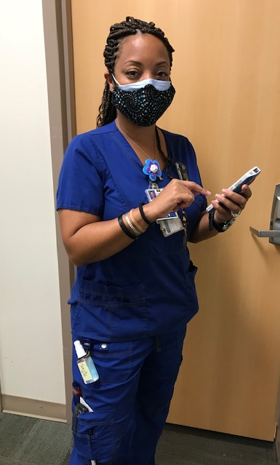
Rover Zebra Smartphone Upgrade
All hospitals (except HMSL): Tuesday, Aug. 3
Devices need to be fully charged and on from 1 to 8 a.m.
The Rover smartphone upgrade is Tuesday, Aug. 3, 1 – 8 a.m. for all hospitals except HMSL.
Before the upgrade − phone on, battery charged
Ensure your smartphone is turned on with the battery fully charged.
If you don’t, your phone won’t receive the Aug. 15 Epic Update and won’t function properly.

Slide 3
Rover Zebra Smartphone Upgrade
During the upgrade
Your individual downtime will last about five to 10 minutes.
Rover will drop what you have in progress. When you log back in, Rover will prompt you about incomplete work. You can then continue documenting where you left off.
You can still use your phone for calls, but use Epic on workstations for documentation.
After the upgrade
Activate the Rover app.
For the End User License Agreement, tap Accept.
Then login as usual.
What’s new
Updated Rover app.
Banner at top of Rover login screen on Zebra phone and Epic on workstations.

Slide 4
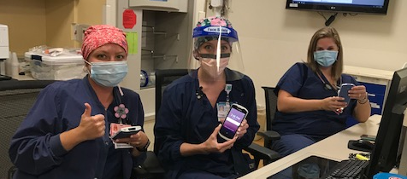
Rover Zebra Smartphone Upgrade
Questions?
it.houstonmethodist.org/rover
it.houstonmethodist.org/help
helpdesk@houstonmethodist.org
IT Help Desk, 832.667.5600

