Slide 1
Aug. 15 Epic Update
Anesthesia Staff
Meeting in a Box
Created: July 27, 2021

Slide 2


Next Epic Update
Sunday, Aug. 15
The next Epic Update
Sunday, Aug. 15
Promotes patient safety and quality, simplifies workflows and improves productivity and financial outcomes.
No reports or clicking acknowledge buttons – reviewing Update Companions is encouraged, not required.
Top Changes by role added to the first page of Companions for at-a-glance views.
For more information about this update, including links to your Update Companion,
visit your Epic Learning Home or it.houstonmethodist.org/epicupdate/

Slide 3

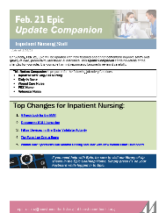
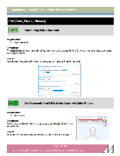
Prepare for the Update
Your Steps to Success
Understand the Top Changes for your role or department.
More places to review your Update Companion.
  Available in the Epic Learning Home,
  targeted eNewsletters and at
  it.houstonmethodist.org/epicupdate/
Practice Guided Activities in the Epic Playground.
1
2
3

Slide 4

Aug. 15 Epic Update
Epic Downtime and Change Freeze
Planned Epic Downtime
Sunday, Aug. 15 from 2 to approx. 3:30 a.m.
Some Epic Functionality Unavailable
Tues., Aug. 11 at 5 a.m. to Sun., Aug. 15 at 3:30 a.m.
During the downtime, access the Epic Read-Only icon on your workstation desktop.
  Data in Epic Read-Only is current
  until the downtime begins.
  You can’t document or enter orders in Epic Read-Only.
For details on what to do before, during and after the downtime, including special instructions for lab, radiology, cardiology and medical devices, visit it.houstonmethodist.org/downtime.
Some Epic functions will be unavailable, and no changes or enhancements will be.
You’ll still be able to work in Epic as usual, but you won't be able to do the following:
  Apply filters in Chart Review.
  Create, edit and share NoteWriter macros, SmartPhrases and SmartLinks.
  Create and edit In Basket QuickActions.

Slide 5

Top Changes for Anesthesia
Aug. 15 Epic Update
The Top Changes for
Anesthesia Staff:
Active or existing infusions can be added to intra-procedure medications.
Find and replace text.
Place recommended pre-op orders.
Show chat message text in workstation notifications.
New opioid medication icon in Storyboard.
Click here for the
Anesthesia
Update Companion
Open in Google Chrome or Microsoft Edge

