Slide 1
HR Staff Notes
July 2021
Updated July 1, 2021

Slide 2

Summer of R&R
For the rest of the summer, Houston Methodist will show you our heartfelt appreciation with fun activities, contests, giveaways and resources to help you rest and recuperate.

Slide 3

Summer of Rest and Recuperation
Astros Contest
Ice Cream w/ CEO
HEB
Contest
Lunch with Your Boss
Snack Day
?
?
?
?

Slide 4
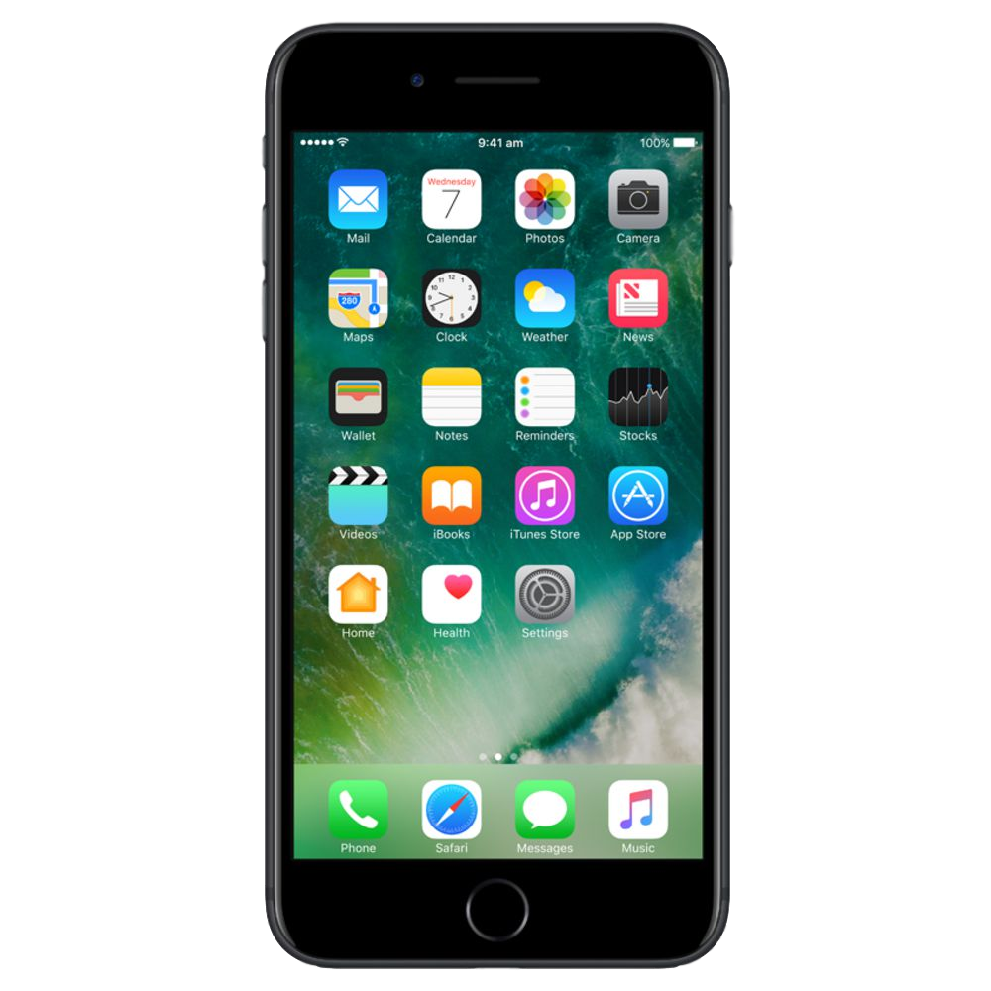

Sign Up to Receive Texts
Sign up to receive news from HR via text message to your mobile device.
Go to MyHRTexts.com to opt in to receive texts.
Or text myHR Texts to 45991 to sign-up for texts.
HM
Be aware of important deadlines.
Get severe weather information.

Slide 5
Join an Employee Resource Group
Employee resource groups are led by employees who join together based on common interests, backgrounds or demographics to create a diverse and inclusive workplace. Text ERG to 45991 to learn more.
Asian Heritage
Black Ties for Culture
LGBTQ+Allies
Hispanic LatinX Alliance
For more information, or if you are interested in starting your own ERG, contact Nazia Imrose at nimrose@houstonmethodist.org.

Slide 6
Join an Employee Resource Group
If you are interested in helping to start one of the following ERGs or if you are interested in starting your own ERG, contact Nazia Imrose at nimrose@houstonmethodist.org.
Veteran’s ERG
People with Disabilities
Single Parents
Middle Eastern/Immigrants & Refugees

Slide 7

Chat with a HR Hub Representative
The HR Hub has expanded our chat capability, and we are now able to chat with employees online Monday – Friday from 7:30 a.m. – 5 p.m.
Log on to MARS.
Click the Benefits or Payroll tile
Click on the Live Chat logo
Chat available in many languages – Spanish and Vietnamese to name a few.

Slide 8
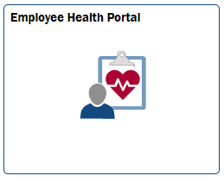
Is Your Birthday in July?
Happy Birthday!
Don’t forget that you must now complete your annual employee health evaluations by the last day of your birth month
Log on to MARS
Click on the Employee Health Portal tile
Click on the Message Center and complete your TB risk assessment questionnaire
If a TB test is not needed, no further action is required. If a TB test is needed, schedule an appointment Employee Health.

Slide 9

New Internal Career Website
Career resources for staff and leaders

Slide 10
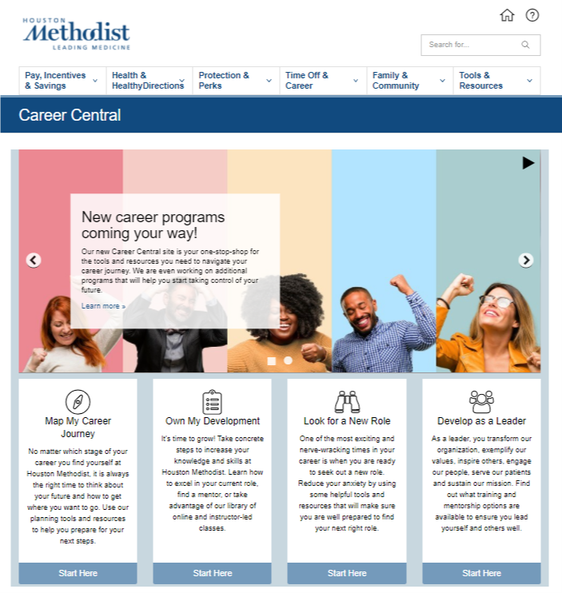
Resources to Facilitate Career Growth
Available from any computer or mobile device
What can you find on Career Central?
Free career assessments: Gain insight into your skills, interests and career values so you can align what you do with what you love.
Recommended steps for career growth: Follow practical on-the-job advice to expand your influence and gain new skills, seek out mentors to help you along the way, and find convenient outlets to gain new knowledge.
Guidance to explore new opportunities: View our custom video collection that will assist you with identifying your next best role, how to properly put together a resume and how to navigate the interview process.
Options for building leadership skills: Explore a variety of internal and external resources that you can use to develop your leadership acumen.
For more information, text myCareer to 45991
or visit myhr.houstonmethodist.org

Slide 11
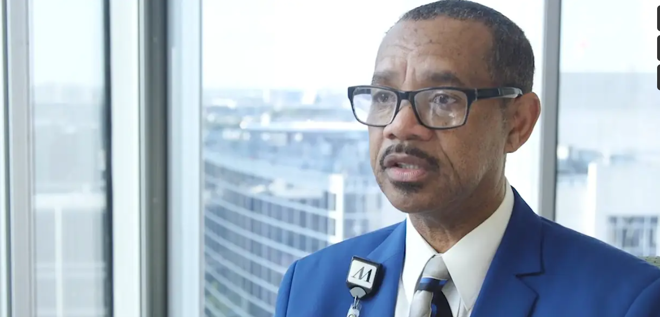
Pathway to Unparalleled: Compassionate Communication Huddle Jerry’s Story
Discussion Questions
Watch Jerry’s Video by Clicking Here
How do you relate to Jerry’s story? What emotions are present?
What makes this a good example of compassionate communication?
Which of these 5 compassionate communication tools are being used?
Be present in the moment.
Listen with your ears and eyes.
Engage with question.
Let your actions show you understand.
Remember the 10/5 rule?
Jerry describes compassionate communication as contagious. How do you think the use of compassionate communication impacts our team? Our customers, patients, and guests?
How can you apply compassionate communication within your team? Within your own work?
Click Here to View Video of the 5 Compassionate Communication Tools

Slide 12
Choose Designee for Compassion Benefit
Houston Methodist offers a $10,000 Compassion Benefit for all employees except those classified as temporary. If you designate a beneficiary for this money, it can typically be paid out within two or three business days following the notification of the employee’s death.
If you don’t designate a beneficiary, the money is paid to your estate and that will delay the receipt of the funds.
Log into MARS and click on the Benefit Details tile
Choose Compassion Benefit (on the left side of the page)
Scroll down and click Edit. Enter your designee’s demographic information and click Save.

Slide 13
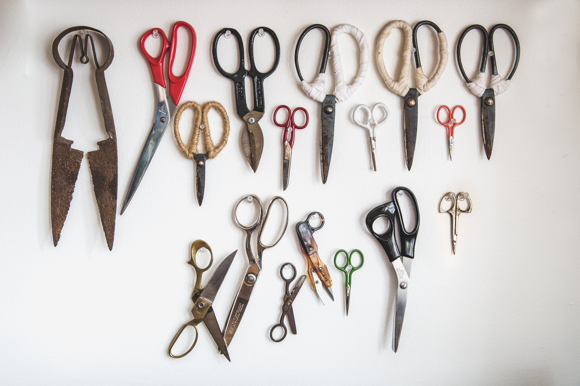
BP in Practice
Privacy & Confidentiality
Collection Complications
STARTING A NEW HOBBY?
During the pandemic, many of us have taken up new hobbies: gardening, exercising, or baking. Maybe even starting a collection of coins, stamps, or baseball cards. But there’s one type of collecting Business Practices wants you to beware of. In this month’s edition of the BPiP, we’re discussing the complications that can come with collecting paper PHI.

Slide 14

BP in Practice
Privacy & Confidentiality
THE PERILS OF PAPER
One of the most common causes of privacy breaches at Houston Methodist is the mishandling or misplacement of paperwork that contains protected health information (PHI). As a reminder, PHI is any patient identifiable health information, including demographic and financial information, that is maintained or transmitted by Houston Methodist. So how do these mistakes happen?

Slide 15
BP in Practice
Privacy & Confidentiality
STARTING A COLLECTION
Sometimes employees will print and use paperwork containing PHI, then add that paper to a stack on a desk or in a box on the floor, intending to take it all to a shred bin at the end of the day or when the box gets full. But this is a risky habit.
When employees delay or forget to take their collection of PHI to the shred bin, it can be mistaken for regular trash that’s picked up by housekeeping and taken to the dumpster, resulting in harm to both our patients and Houston Methodist.

Slide 16
BP in Practice
Privacy & Confidentiality
THE BEST PRACTICE
What’s the best way to avoid a collection complication? Instead of letting paper PHI stack up on or under your desk, make a new habit of taking paper PHI to a shred bin as soon as you’re done working with it. It might mean a short walk a few times a day, but that little bit of extra effort goes a long way in preventing privacy breaches. If your work area could use more shred bins, let management know. And if you ever have questions about best practices for protecting patient privacy, contact Business Practices.
Now That’s Living the Houston Methodist Values Through
Business Practices!
For more information, review System Policies IM06, HR12, and the Respecting Health Information Privacy handbook. View previous editions of the BP in Practice on the BP homepage.

Slide 17
Reminder Mental Health Resources
Are you feeling stressed out or worried? Three ways to access care
Call LifeMatters at 800.634.6433. You can get up to 10 free sessions with a counselor.
$0 copay for all mental health in-network office visits.
Reimbursement up to $85 for out-of-network office visits.
Need help? Call quantum to find an in-network provider or to file an out-of-network claim.

Slide 18
Focus on Completing Your Health Track
The deadline to complete your Health Track and save hundreds of dollars on your medical premium for 2022 is Sept. 30, 2021.
Guided Health Track
Call 346.238.5400 to set an appointment with a care navigator and develop your personalized health improvement plan
If you have diabetes, you may complete the track through your free benefit for participation with Livongo.
Do-It-Yourself (DIY) Health Track
Online Journeys with Virgin Pulse
Houston Methodist Wellness offers a wide variety of free programs, including virtual classes, that will help you earn points toward completing your Health Track.
New Hire Health Track
Register with Virgin Pulse at join.virginpulse.com/healthydirections.
Earn 20,000 points in the Virgin Pulse platform.

Slide 19
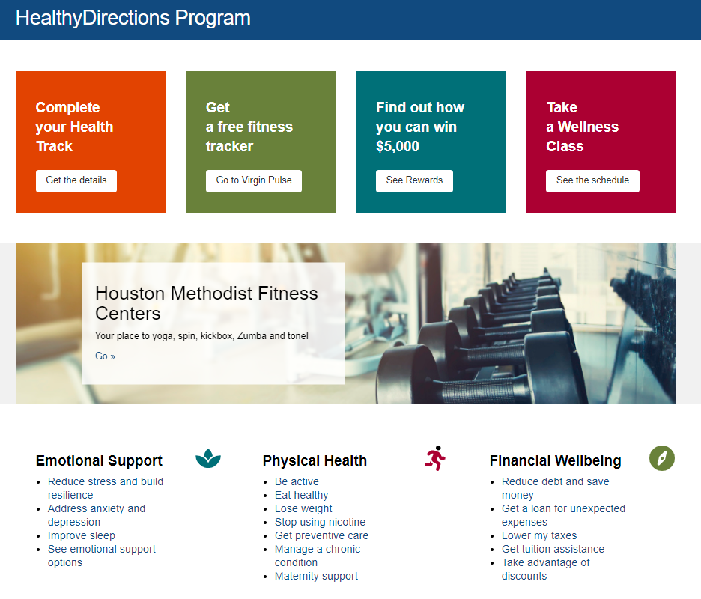
HealthyDirections Page
HealthyDirections page has a new look. Visit myhr.houstonmethodist.org, click HealthyDirections tab and view the new page on the HealthyDirections Program.

Slide 20
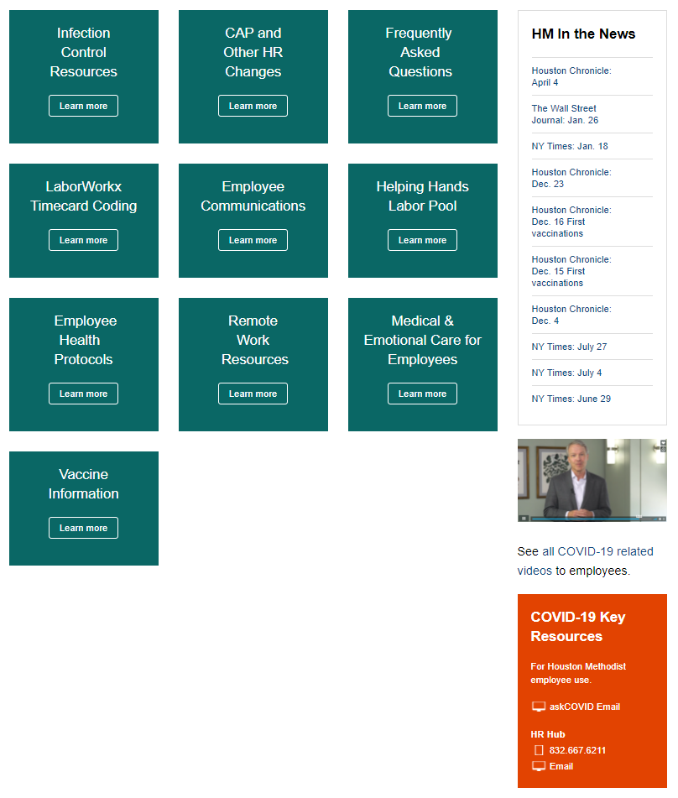
COVID-19 Resources on myhr.houstonmethodist.org
Text COVID to 45991 to view COVID-19 Resources.

Slide 21
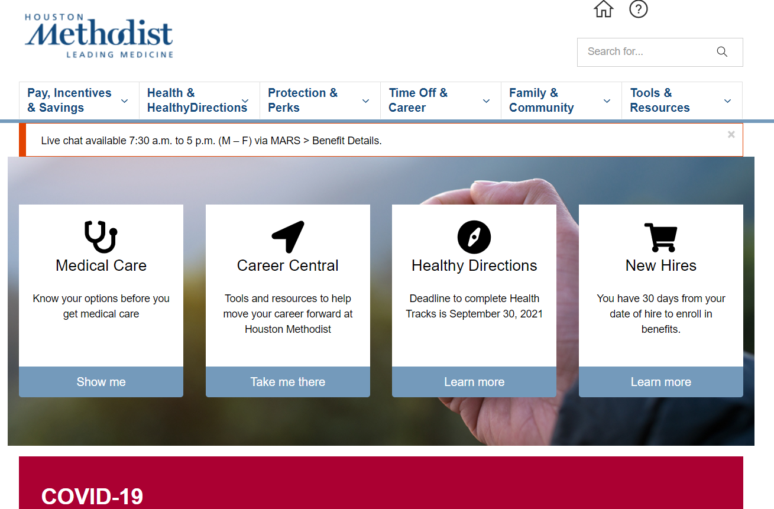
Want to be Better Informed on Your Benefits?
visit myHR.houstonmethodist.org
Easily access information about your total rewards from wherever you are — at work, home or on the go:
• Health care plans
• 2021 premiums
• PTO
• HealthyDirections
• Pay and incentive programs
• Retirement benefits
• And more
Text myHR to 45991 to get the link in a text.
Use the search function to find information easily.

Slide 22

Get Answers to Your Benefits Questions
    Call: 832.667.6211
    Email: hrhub@HoustonMethodist.org
1
2
If you’re not reading the HR Hub weekly email, sent Wednesday afternoons, you’re missing valuable information.

Slide 23

Text 45991
Take a picture of the text codes for reference when needed.
Text Code | Subject
COVID | COVID-19 Resources web page
ERG | Employee Resource Groups (ERGs) page.
HD | HealthyDirections
Virgin Pulse | Virgin Pulse website
myHR | myHR.HoustonMethodist.org
myHR Texts | Sign up to receive HR messages via text
Prayer | Submit prayer request to HM chaplains
myCareer | Career Central website

Slide 24

Dates to Remember
July 9 | Deadline for staff to complete self-evaluations
Week of July 11 | Employee Pulse Survey begins
July 19-20 | Eid al-Adha (Islamic holiday)
Aug. 10 | Patient Satisfaction Bonus payout
Aug. 25 | Last day to complete FPR in-services
Aug. 30 | Krishna Janmashtami (Hindu holiday)
Sept. 6 | Labor Day holiday

