Slide 1
IV Pump Integration with Epic
Overview for HMTW
May 20, 2021

Slide 2
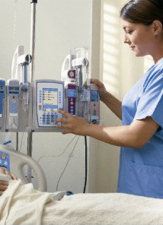
Overview
IV Pump Integration
IV Pump Integration seamlessly integrates
with Epic for improved patient safety
and more efficient documentation.
IV Pump Integration begins at HMTW
on Tuesday, June 8, 2021 and launches
systemwide throughout 2021 and 2022.
Classroom-based training will be held starting April 19
in the HMTW Main Computer Lab. Courses are
interactive, hands-on and last approx. two hours.
Appropriate courses have been assigned in
LMS for impacted staff, who must register
for a specific session in LMS.

Slide 3
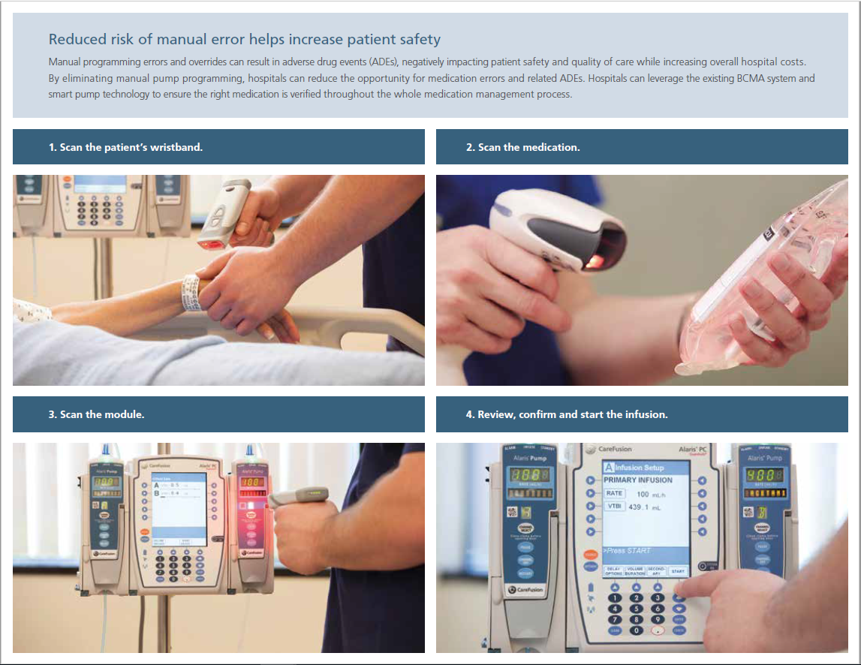
Basic How-To
IV Pump Integration

Slide 4
Impacted Units
IV Pump Integration
The following units are impacted by this project launch
4N, 5N, 6N, 6S (Med Surg)
AOD/PACU (OR/Spec Procedures)
Cath Lab
ED (Main/Woodlands ECC)
Endoscopy
ICU
Infusion Center
Interventional Radiology
Women’s Services (Antepartum, L&D, NICU, OB ED)

Slide 5
Why Are We Doing It?
IV Pump Integration
IV Pump Integration is easy to use, with fewer buttons
to click and automated documentation
of infusion start/stop times.
Allows you to spend less time documenting and more
time caring for patients when administering IV infusions.
Reduces the need to manually search for, enter
and document IV med details.
Documentation will be more detailed and precise,
enabling better patient outcomes.
Decreases errors when managing
complex IV infusions and improves patient safety.

Slide 6
Training
IV Pump Integration
Classroom-based training is assigned in LMS.
Impacted nurses need to register in LMS for the applicable Epic IV Pump Integration Training session for their role.
ED Only - Course ID 1589056
Infusion Therapy Only - Course ID 1589057
All Other Units - Course ID 1589055
Classes are in the HMTW Main 3rd Floor Computer Lab (room 3461).
Each course is approx. two hours long.
Deadline for training completion is Fri., June 4.

Slide 7



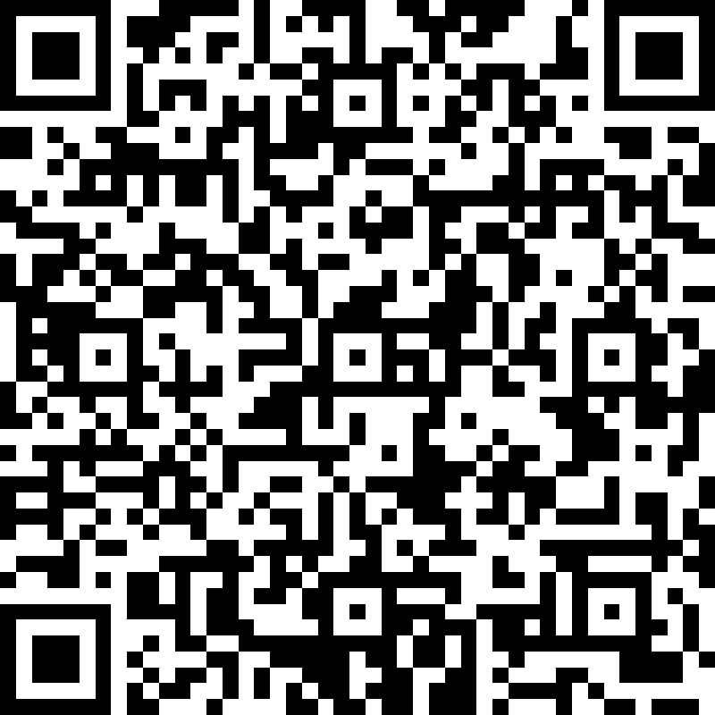
Feedback
IV Pump Integration
We want to hear from you!
Complete the pre- and post-launch surveys to help us prepare for future project launches.
For the pre-launch survey, scan this QR code or visit https://forms.office.com/1sBWS3XHhm

