Slide 1
March 7 Epic Update
Transplant
Meeting in a Box
Created: Feb. 2, 2021

Slide 2


Next Epic Update
Sunday, March 7
The next Epic Update
Sunday, March 7
Promotes patient safety and quality, simplifies workflows and improves productivity and financial outcomes.
No more reports or clicking acknowledge buttons – reviewing Update Companions is encouraged, not required.
Top Changes by role added to the first page of Companions for at-a-glance views.
For more information about this update, including links to your Update Companion,
visit your Epic Learning Home or it.houstonmethodist.org/epicupdate/

Slide 3
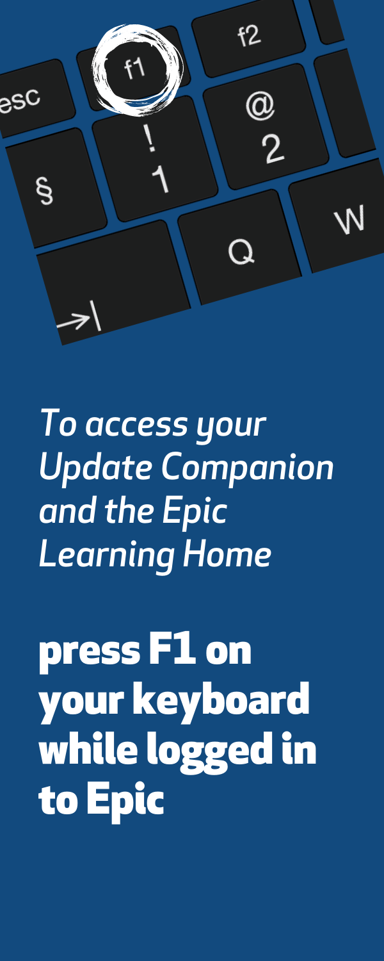


Prepare for the Update
Your Steps to Success
Understand the Top Changes for your role or department.
More places to review your Update Companion.
  Available in the Epic Learning Home,
  targeted eNewsletters and
  at it.houstonmethodist.org/epicupdate/
Practice Guided Activities in the Epic Playground.
1
2
3

Slide 4

Top Changes for Transplant Coordinator
The Top Changes for
Transplant Coordinators:
The redesigned Transplant Information activity is more efficient to navigate transplant episode documentation.
Monitor transplant recipient and donor progression times with an improved dashboard component.
Use Chart Search to find Episode Checklist Tasks quickly.
Transplant episodes are visible in the Storyboard Hover Bubble.
Click here for the
Transplant Coordinator
Update Companion
Open in Google Chrome or Microsoft Edge

Slide 5
Top Changes for Transplant Staff
The Top Changes for
Transplant Support Staff:
The redesigned Transplant Information activity is more efficient to navigate transplant episode documentation.
Monitor transplant recipient and donor progression times with an improved dashboard component.
Use Chart Search to find Episode Checklist Tasks quickly.
Transplant episodes are visible in the Storyboard Hover Bubble.
Repopulate UNOS Thoracic Follow-up forms to update rounding in Pulmonary Function tests.
Click here for the
Transplant Support Staff
Update Companion
Open in Google Chrome or Microsoft Edge

