Slide 1
March 7 Epic Update
LTC/SNF Staff
Meeting in a Box
Created: Feb. 2, 2021

Slide 2


Next Epic Update
Sunday, March 7
The next Epic Update
Sunday, March 7
Promotes patient safety and quality, simplifies workflows and improves productivity and financial outcomes.
No more reports or clicking acknowledge buttons – reviewing Update Companions is encouraged, not required.
Top Changes by role added to the first page of Companions for at-a-glance views.
For more information about this update, including links to your Update Companion,
visit your Epic Learning Home or it.houstonmethodist.org/epicupdate/

Slide 3

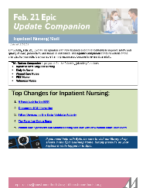
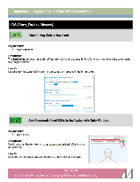
Prepare for the Update
Your Steps to Success
Understand the Top Changes for your role or department.
More places to review your Update Companion.
  Available in the Epic Learning Home,
  targeted eNewsletters and
  at it.houstonmethodist.org/epicupdate/
Practice Guided Activities in the Epic Playground.
1
2
3

Slide 4

Top Changes for LTC/SNF Staff
Epic Update
The Top Changes for
LTC/SNF Staff:
Use the LOA Update button to easily update a patient’s leave of absence information.
You can now filter information in the Data Validate activity to focus on data from a single device.
The Event Log’s new, efficient layout saves you time with a main event pane and sidebar for graphs and reports.
Click here for the
LTC/SNF Staff
Update Companion
Open in Google Chrome or Microsoft Edge

