Slide 1
March 7 Epic Update
Anesthesia Staff
Meeting in a Box
Created: Feb. 2, 2021

Slide 2


Next Epic Update
Sunday, March 7
The next Epic Update
Sunday, March 7
Promotes patient safety and quality, simplifies workflows and improves productivity and financial outcomes.
No more reports or clicking acknowledge buttons – reviewing Update Companions is encouraged, not required.
Top Changes by role added to the first page of Companions for at-a-glance views.
For more information about this update, including links to your Update Companion,
visit your Epic Learning Home or it.houstonmethodist.org/epicupdate/

Slide 3
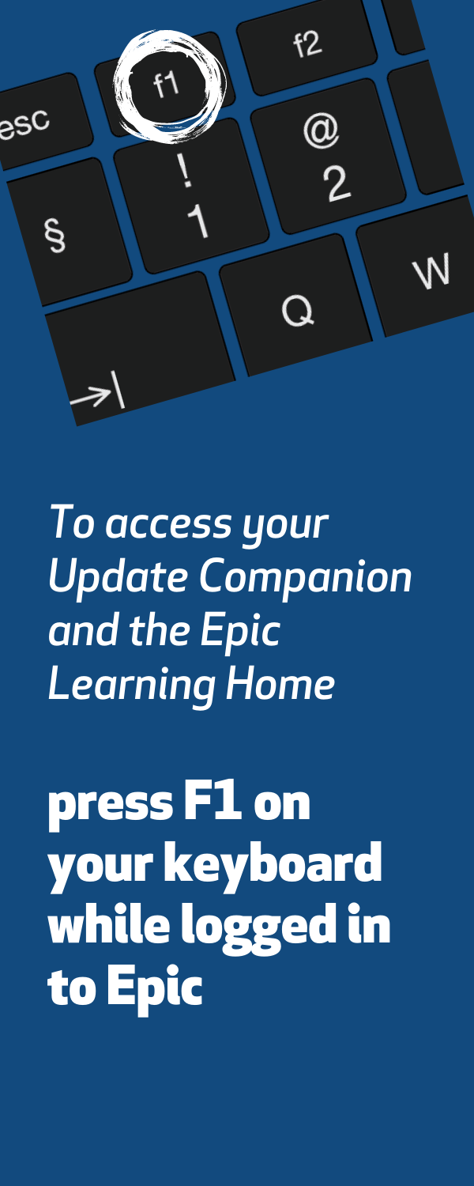


Prepare for the Update
Your Steps to Success
Understand the Top Changes for your role or department.
More places to review your Update Companion.
  Available in the Epic Learning Home,
  targeted eNewsletters and
  at it.houstonmethodist.org/epicupdate/
Practice Guided Activities in the Epic Playground.
1
2
3

Slide 4

Top Changes for Anesthesia Staff
Epic Update
The Top Changes for
Anesthesia Staff:
Look for the Watch meds column in the Anesthesia Storyboard to see whether your patients are taking any medications you need to watch carefully.
Complication tracking is now seamlessly integrated into Anesthesia’s Intraprocedure Activity.
Use the LDA Avatar for a visual representation of a human body to document the placement, assessment and removal of lines, drains and airways.
Document medication administration easily in the new Admin form in the Medication Administration window.
Click here for the
Anesthesia Staff
Update Companion
Open in Google Chrome or Microsoft Edge

