Slide 1
Staff Telemedicine Training
Epic MyChart Video Visits

Slide 2
Agenda
Scheduling
Patient Preparations
Troubleshooting Issues
Billing

Slide 3
Scheduling
Patients must be located in a state where the provider is licensed (potentially others during an emergency).
Video visits are dictated by the provider.
Patient selection criteria is determined by the provider.
  Criteria may include patient diagnosis or visit type.
Staff schedules patients per usual with MyChart Video Visit type.
To ensure punctuality, schedule video visits in the morning or early afternoon.

Slide 4
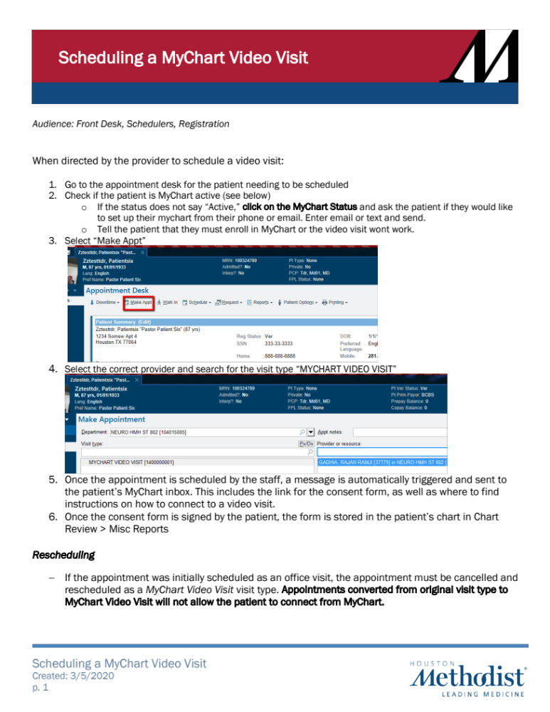
Scheduling

Slide 5
Patient Preparations
Once scheduled, patients will receive instructions and consent forms via MyChart and a text via WELL.
Before the visit, staff should call patients to help them download the MyChart app, locate and sign consent forms and answer technical questions, prior to the video visit.
Patients are instructed to join the video visit five minutes prior to their appointment and wait for the provider.

Slide 6
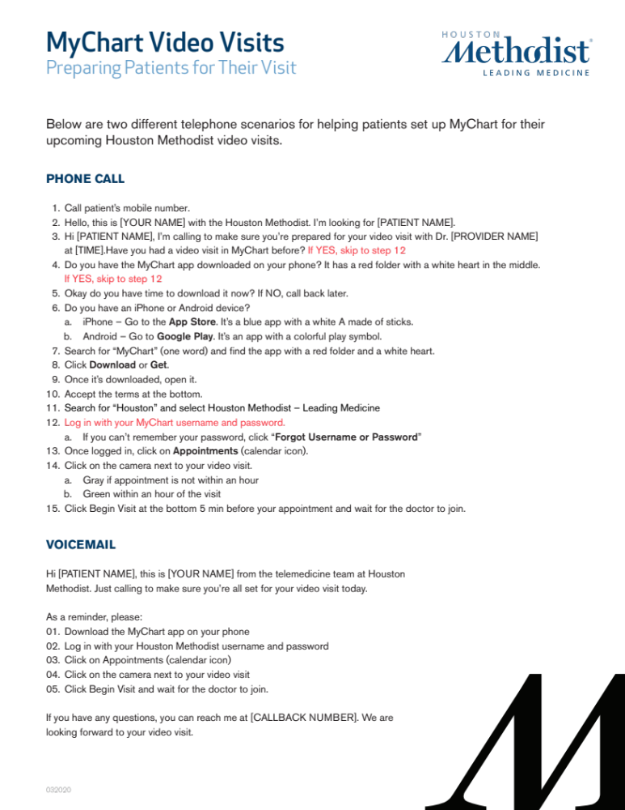
Patient Preparations

Slide 7
Troubleshooting Issues
Most Frequent
Patient isn’t joining:
  Call the patient and ask them to select BEGIN VISIT.
  Have the Provider send a TEXT INVITE.
Patient/Provider can’t hear:
  Have the patient make sure the sound is turned on for the device. If on an iPhone, make sure the sound switch on the top left of the phone is clicked toward them. If it’s still not working, quit the website/app and log in again. If still not working, restart the device.
Video feed isn’t loading or is slow:
  Ask the patient to connect to Wi-Fi or turn off Wi-Fi and use their cellular data.

Slide 8
Billing
Services rendered during the global period will be billed/not billed according to normal billing rules.
All other services rendered are billed as usual and converted to a $50 cash pay service.
Patients may take the receipt to their insurance company to be reimbursed.
With changes in the last week, Houston Methodist is looking into what we can do regarding bill payers.

Slide 9
Support
If a patient hasn’t connected, call the patient and ask if they need help.
If you or the patient needs help connecting, email TelemedSupport@HoustonMethodist.org with “URGENT” in the subject line.
If you have questions, email: TelemedSupport@HoustonMethodist.org, or contact Josh Hjelmstad at jhjelmstad@houstonmethodist.org.

Slide 10
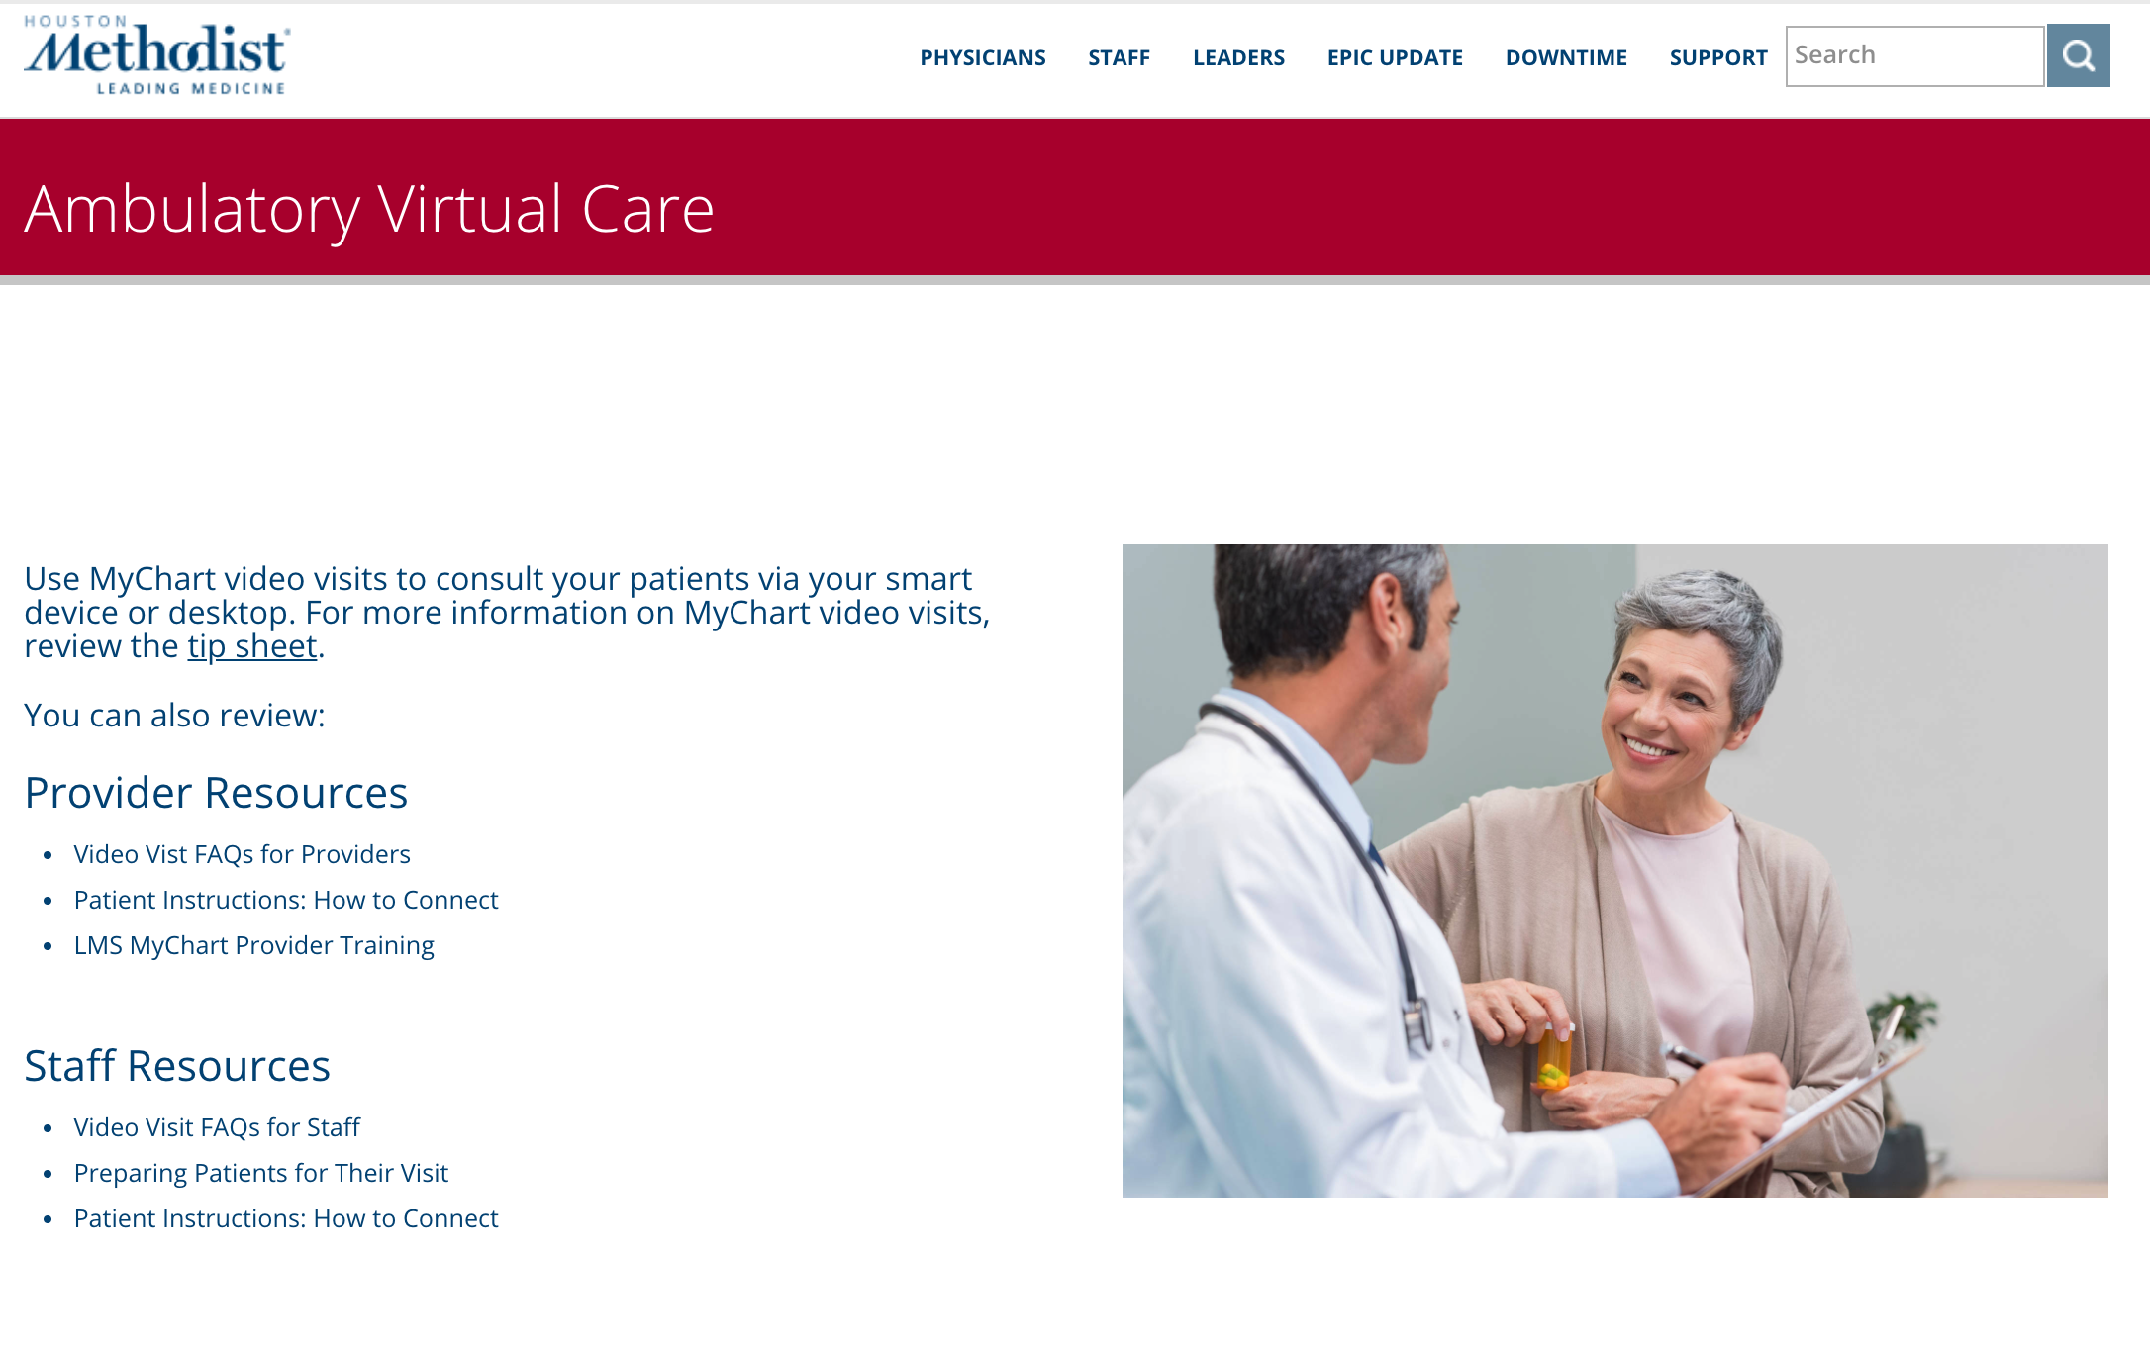
Questions?
Resources:
  https://it.houstonmethodist.org/ambulatory-virtual-care/

