Slide 1
WebEx − Using It with Apps Center

Slide 2


Objectives
By the end of this eLearning, here’s what you’ll be able to do
Set up WebEx to use with Apps Center.
Schedule a WebEx meeting.
Join a WebEx meeting.
Share your content.
Learn where to find additional resources.

Slide 3
About WebEx
What’s WebEx?
Allows you to schedule or attend online meetings.
Available on all your devices (for smartphones, download the WebEx app).
Share your screen with others, so they can see a presentation or other documents.

Slide 4
Set Up WebEx for Apps Center

Slide 5
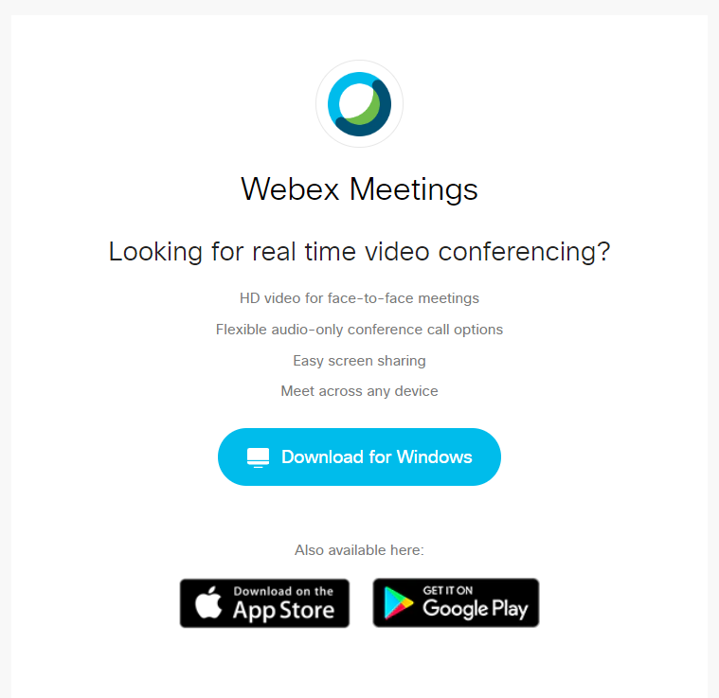
Set Up WebEx for Remote Use
From Apps Center, Outlook doesn’t have the Add WebEx Meeting button
Install WebEx app.
Go to https://www.webex.com/downloads.html/.
Download the app on your personal laptop or desktop.
An upcoming video in this eLearning will show you how to do this.

Slide 6
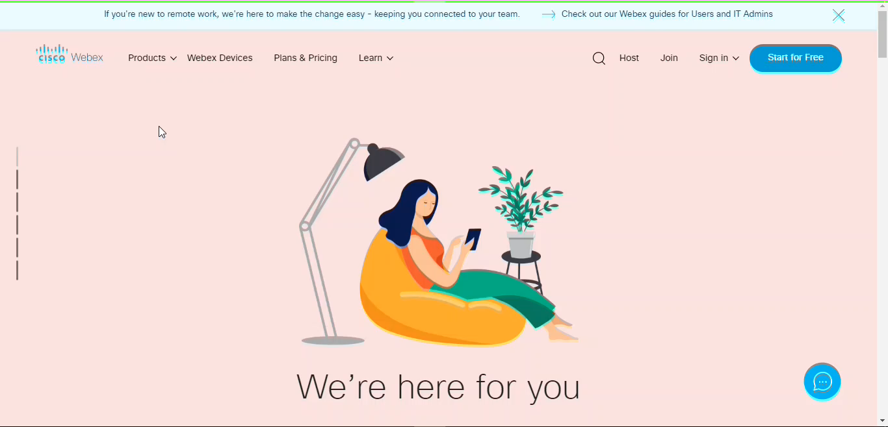
Set up WebEx

Slide 7
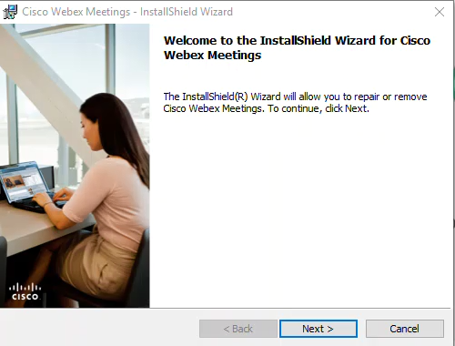
Install WebEx
Double-click the file that downloads. You can see it in the lower-left corner of your web browser window.
Follow the instructions on the window that appears.

Slide 8
Schedule a WebEx Meeting

Slide 9
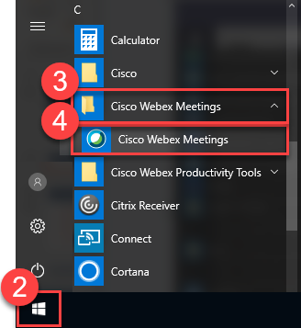
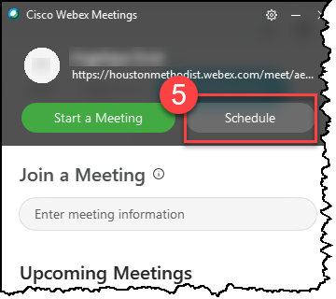
Schedule WebEx Meeting
Click the Start menu.
Scroll to the Cisco Webex Meetings folder and click it to expand it.
Click the application Cisco Webex Meetings.
From the WebEx pop-up, click Schedule.

Slide 10
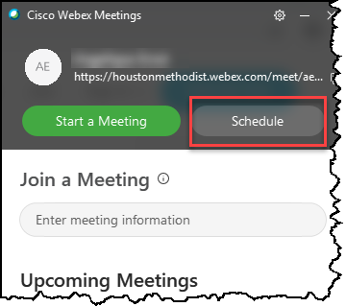
Schedule WebEx Meeting
After you click Schedule in the pop-up:
A new Outlook meeting window appears. Enter the meeting title and attendees.
For Location, type in WebEx.
Click Add WebEx Meeting.
WebEx autogenerates information in the body of the meeting invite. Details about the WebEx appear when you click Send.

Slide 11
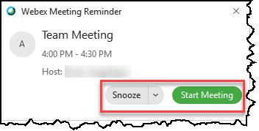
Meeting Reminders
WebEx will remind you when your meeting time is approaching.
From the pop-up window, you can click Snooze or Start Meeting.

Slide 12
Connect to a WebEx Meeting

Slide 13
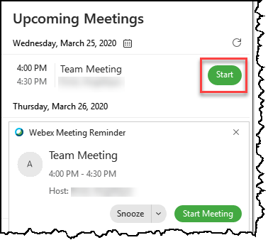
Start a Meeting with WebEx
There are several ways to begin your WebEx meeting.
One way is through the WebEx window that appears. Click Start.
You can also Snooze or Start Meeting.

Slide 14
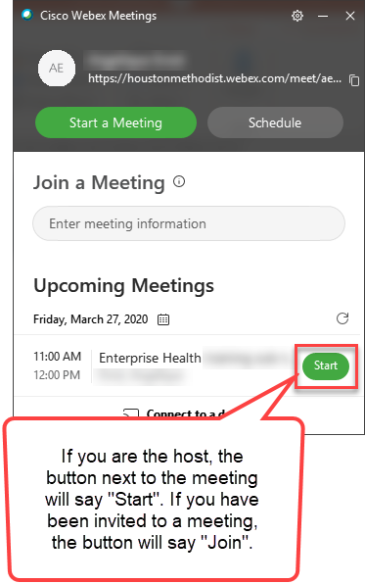
Connect to a WebEx – Option 1
There are several ways to connect to a WebEx meeting, no matter how you are logged in the Houston Methodist network.
From the Start menu > Cisco WebEx Meetings folder > Cisco WebEx Meetings
A WebEx pop-up window appears with your upcoming meetings.
Click Start if you are the host or Join if you are an invitee.

Slide 15
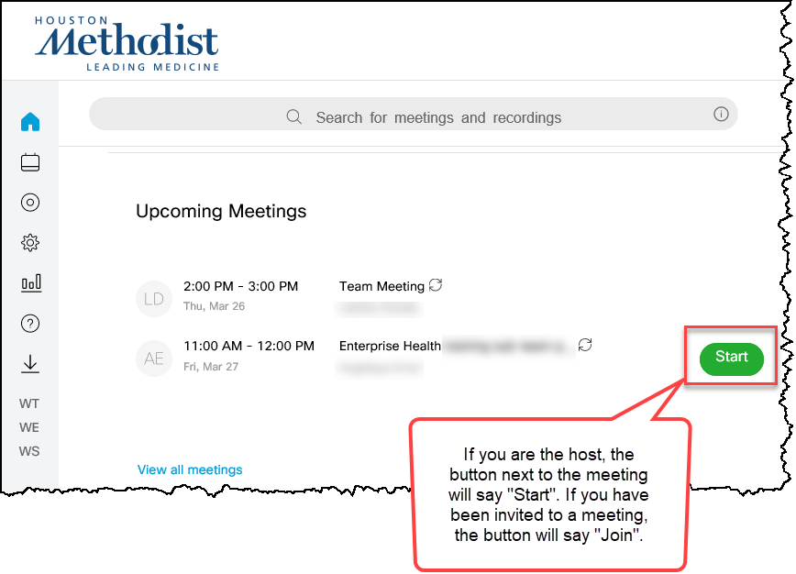
Connect to a WebEx – Option 2
From the HM WebEx site (https://houstonmethodist.webex.com), sign in (if you’re not logged in).
From your Upcoming Meetings,
click Start or Join.

Slide 16
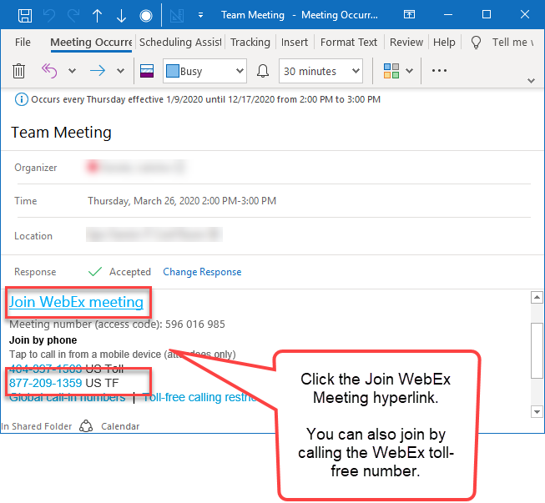
Connect to a WebEx – Option 3
From your Outlook calendar, open the meeting invite.
Click the Join WebEx Meeting hyperlink in the body of the meeting invite.
If necessary, you can also call in using the toll-free number.

Slide 17
Share Your Content

Slide 18
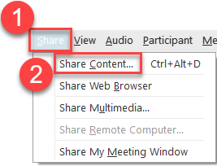
Share Your Content
You can share your screen several ways, depending on what you want to share and with whom.
From the WebEx menu bar at the top of your screen, click Share.
Click Share Content.

Slide 19
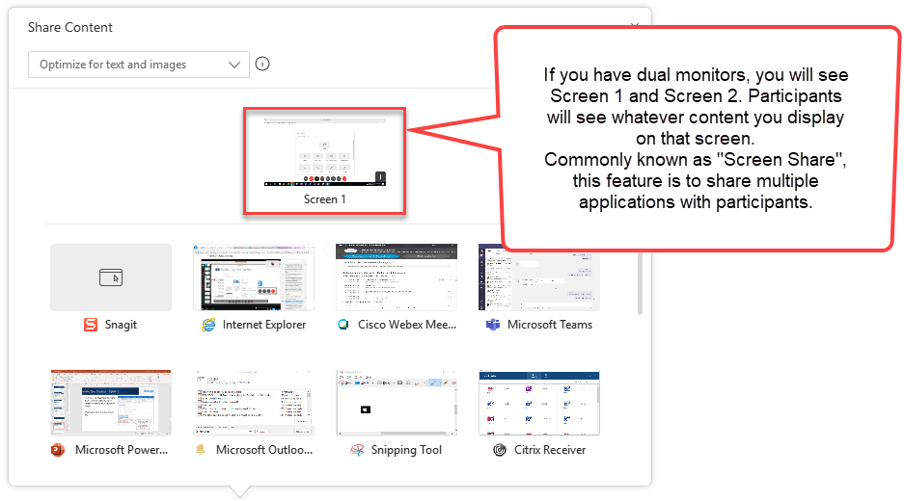
Share Your Content – Screen Sharing
If you have two monitors, you can select which screen to share.

Slide 20
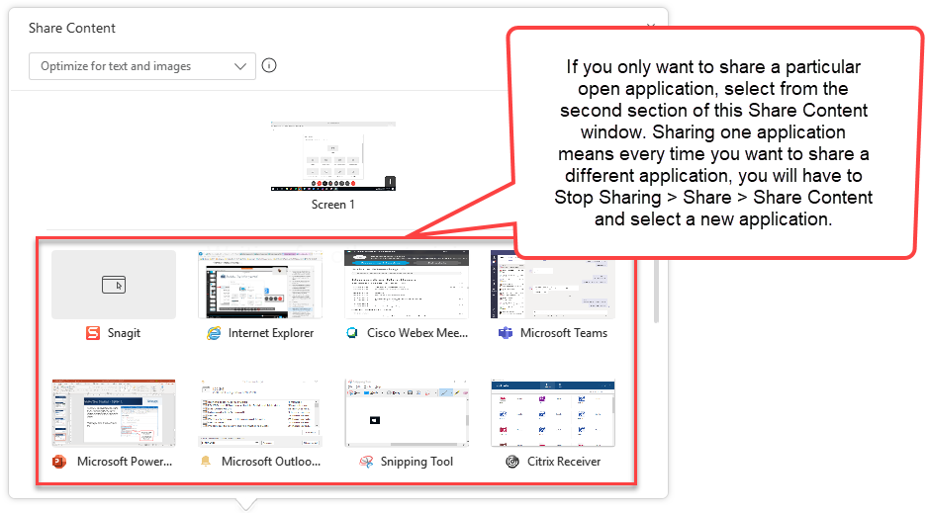
Share Your Content – Application Sharing
You can share a single application.

Slide 21
Share Your Content – Application Sharing
When sharing a single application, if you want to share anything else, here’s how:
Hover towards the top of your screen to pull down the WebEx toolbar.
From there, click Stop Sharing.
To share something else, click Share > Share Content and select what you want to share.

Slide 22
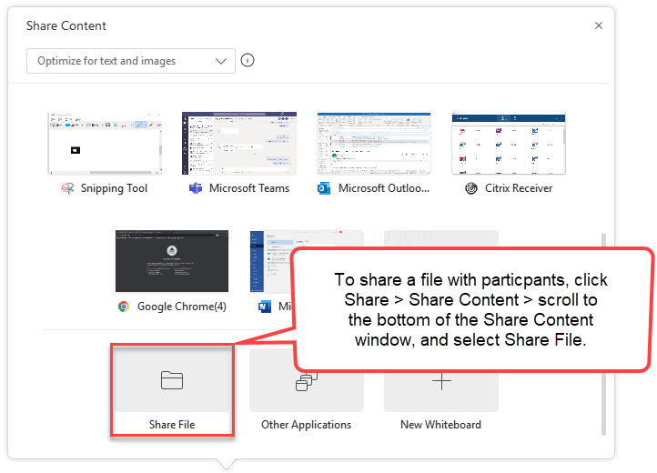
Share Your Content – Sharing Files
You can share files.

Slide 23
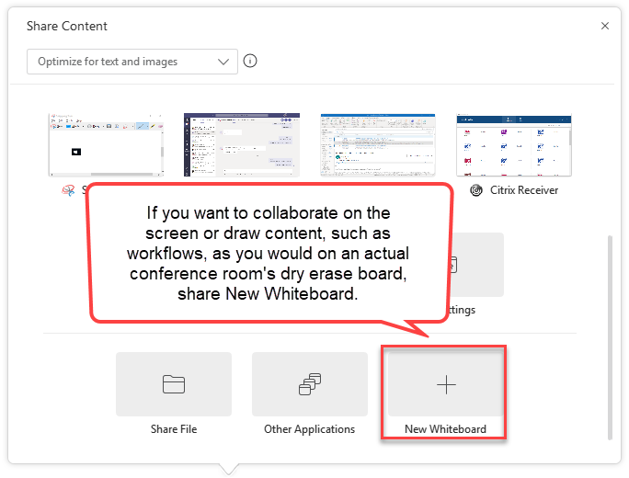
Share Your Content – New Whiteboard
You can share a New Whiteboard.
This mimics a physical conference room, with an actual dry erase board.

Slide 24
Additional WebEx Resources

Slide 25

WebEx Resources
For more WebEx information, visit it.houstonmethodist.org/remote, then click WebEx.
This website also includes other tools and tips for working remotely.

